Slide 1
Camunda Twitter Use case

Slide 2

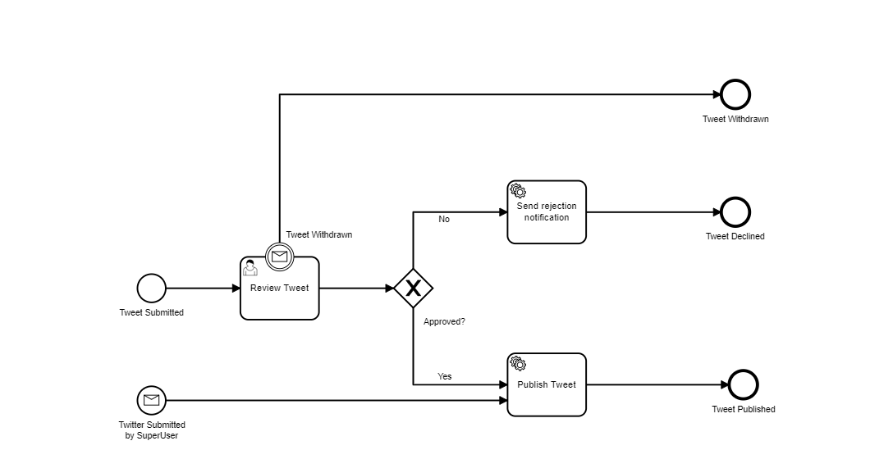
Camunda use case
On submitting tweet, it would be reviewed in “Review Tweet” stage where it can be approved or rejected.
If approved, the tweet would be published on Camunda Tweeter.
If Rejected, Rejection message would be printed, and the tweet would be declined.
If a Super User submit the tweet, it would be directly published without reviewing.
Tweet can be withdrawn in Review stage.

Slide 3
Camunda Use Case Cont.…
Tasks Information:
Tweet Submitted : Start Event
Displays form while starting the process to take tweet content.
Review Tweet : User task - tweet can be approved/rejected/withdrawn here
Display form to pass Boolean variable value to approve/reject the tweet.
Tweet Withdrawn – Message intermediate Catch Event
Tweet can be withdrawn by sending withdrawn message when it is in Review stage. It can be done via REST API:
REST URL: http://localhost:8080/engine-rest/message
Request:
{
"messageName": "tweetWithdrawn",
"resultEnabled": "true",
"processVariables" : {
"content" : {"value" : "my message", "type": "String"}
}
}

Slide 4
Camunda Use Case Cont…
Tasks Information:
Tweet Submitted by Super User: Message Start Event
Super user can publish tweet directly. It can be done via REST API.
REST URL: http://localhost:8080/engine-rest/message
Request:
{
"messageName": "superuserTweet",
"resultEnabled": "true",
"processVariables" : {
"content" : {"value" : "my message", "type": "String"}
}
}
Publish Tweet : Service task -
Call configured Java class to publish tweet to Camunda tweeter.
Send Rejection Notification – External Service Task
It waits for an external task that has subscribed for the same topic. The external task would print rejection notification message.

